Slide 1

Prof. Sureka Chackrewarthy
Department of Biochemistry & Clinical Chemistry
Faculty of medicine , Ragama

Slide 2
HEME BIOSYNTHESIS AND PORPHYRIAS
BIOSYNTHESIS OF HEME
Heme is a porphyrin complexed with an iorn atom.
Protoporphyrin + Fe⁺² Heme
Quantitatively the most important porphyrin in
humans.
Heme is produced in almost all mammalian
tissues, most pronounced in bone marrow and
liver.

Slide 3
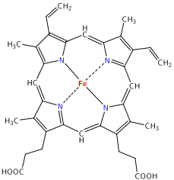
Porphyrin + Fe = heme

Slide 4
Mitochondria
Heme Biosynthesis
Glycine + Succinyl co A
(PBG synthase)
ALA dehydratse
cytosol
Vit B ALA synthase
(PLP)
δ- aminolevilinic acid (ALA)
Porphobilinogen
Uro PG I synthase
(PBG deaminase)
Hydroxymethylbilane
Uro PG I syn
Uro PG III cosyn
spontaneous
Heme
Fe⁺² Ferrochelatase
Uro PG III
Uro PG I
Protoporphyrin III (IX)
Uro PG decarboxylase
Proto PG oxidase
Pro PG III
Copro PG oxidase
Copro PG III

Slide 5
Biosynthesis of heme -
(1). Formation of δ- aminolevulinic acid(ALA)
Occurs in the mitochondria.
Uses pyridoxal phosphate as co-enzyme.
  Rate limiting step in porphyrin biosynthesis.
Succinyl Co A + Glycine ALA + CoASH
+ CO₂
(2). Formation of porphobilinogen
  Occurs in the cytosol
2 ALA prophobilinogen (PBG) + 2H₂O
Aminolevulinic acid dehyratase
-Zn containing enzyme
-Sensitive to inhibition by heavy metal ions -
Eg: Lead poisoning lead to elevation of ALA and
anaemia
Aminolevulinic acid synthase
Aminolevulinic acid dehydratase

Slide 6
(3).Formation of uroporphyrinogen (UPG)
(4). Formation of coproporphyrinogen(CPG)
UPGIII coproporphyrinogen III(CPG III)
CPG III can re-enter the mitochondria.
Uroporphyrinogen I synthase
4 porphobilinogen
Linear tetrapyrrole molecule
Uroporphyrinogen III cosynthase
Uroporphyrinogen I synthase
Linear tetrapyrrole
molecule
UPG III
spontaneously
UPG I
Uroporphobilinogen decarboxylase

Slide 7
(5)Formation of heme
Protoporphrin Heme
Involves the incorporation of ferrous ion in to
the Protoporphyrin.
Can be inhibited by lead.
Heme biosynthesis occurs in most mamalian cells with the exception of mature red cells, which do not contain mitochondria.
Coproporphyrinogen oxidase
CPG
protoporphyrinogen III(PPGIII)
Protoporhyrinogen oxidase
Protophyrin III or IX(PP III or IX)
Heme synthase/ Ferrochelatase

Slide 8
REGULATION OF HEME SYNTHESIS
Regulation in the liver:
The first committed step in heme biosynthesis catalysed by ALA synthase which the regulatory enzyme.
Heme or its oxidised product hemin (Fe3+) controls the enzyme activity
1. Feedback inhibition
2. Repression/ derepression of ALA synthase (via an aporepressor)
Heme + aporepressor active repressor
Repression of ALA synthase
gene

Slide 9
3. Inhibition of transport of ALA synthase from cytosol to mitochondria
Effects of xenobiotics on ALA synthase activity
The activity of ALA synthase is increased by
xenobiotics (drugs, phenobarbitol, insecticides,
carcinogens).
Metabolized in the liver by cyt P-450 system.
Cellular levels of heme are depleted due to
extra synthesis of cytochrome.
The reduced heme concentration increases the
synthesis of ALA synthase.

Slide 10
In hypoxia ALA synthase is activated and leads to increase in heme synthesis.
Regulation in the erythropoietic tissues:
ALA synthase does not regulate heme synthesis in
erythroid cells.
Uroporphyrinogen I synthase and ferochelatase
regulate heme synthesis in these cells.
Cellular uptake of iron influences heme synthesis.
Heme stiumulates haemoglobin synthesis, So
that synthesis of heme and globin occur in the
correct proportions to synthesize heamoglobin.

Slide 11
Absorption spectra of porphyrins:
Porphobilinogens respective porphyrins
/Porphyrinogens (light, oxidants)
All porphyrins have sharp absorption band near 400nm named the Soret band, after its discoverer. This enables the detection of porphyrins even in small quantities.
This property is also useful in cancer treatment
(cancer photoradiation threpay)
Tumors take up more porphyrins than normal tissues.
Hematoporphyrins are administered to patients with
tumors. The tumor is then exposed to an argon laser,
which excites the porphyrins, producing cytotoxic
effects.
Spontaneus oxidation
coloured
colourless

Slide 12
Any excess ALA, PBG and UPG appear in the urine as they are water –soluble.
Protoporphyrins is excreted in bile and appear in the faeces.
Either route may excrete CPG.

Slide 13
PORPHYRIAS
A group of rare disorders caused by deficiencies of enzymes of the heme biosynthetic pathway.
Inherited, occasionally acquired eg: lead (Pb) poisoning.
Affected individuals have an accumulation of heme precursors (porphyrins), which are toxic at high concentrations
Attacks of the disease are triggered by certain drugs, chemicals, and foods, and also by exposure to sun
• Treatment involves administration of hemin, which provides negative feedback for the heme biosynthetic pathway, and therefore, prevents accumulation of heme precursors

Slide 14
PORPHYRIAS
Mitochondria
GLYCINE + SuccinylCoA
ALA synthase
δ-aminolevulinic acid(ALA)
ALA dehydratase
ALA-dehydratase
Deficiency porphyria
Porphobilinogen(PBG)
Acute intermittent
porphyria
PBG deaminase
hydroxymethylbilane
Uroporphyrinogen III
cosynthase
Congenital erythropoietic
porphyria
uroporphyrinogen III
Uroporphyrinogen
decarboxylase
Prophyria
cutanea tarda
coprophyrinogene III
Coproporphyrinogen
oxidase
Herediatary
coproporphyria
Protoporphyrinogene IX
Protoporphyrinogen
oxidase
Variegate
porphyria
protoporphyrin IX
Ferrochelatase
Erythropoietic
protoporphyria
Heme

Slide 15
Some porphyrias have acute presentations (acute intermittent, variegate, hereditary coproporphyria), whereas others have a chronic, relatively stable presentation (congenital, erythropoietic, porphyria cutanea tarda)
Acute porphyrias –
characterized by periodic acute attacks of neurovisceral symptoms. Eg: abdominal pain, neurologic deficits, psychiatric symptoms and colored (red) urine.
Enzymatic defects in the initial steps of the metabolic cascade, leading to accumulation of early metabolic intermediates ALA and PBG, are responsible for attacks of neurologic dysfunction

Slide 16
Chronic porphyrias –
Dermatologic diseases that may or may not involve the liver and nervous system and do not present as acute attacks.
Enzymatic defects are in the final steps, sunlight-induced cutaneous lesions (photosensitivity) due to porphyrin accumulation in the skin

Slide 17
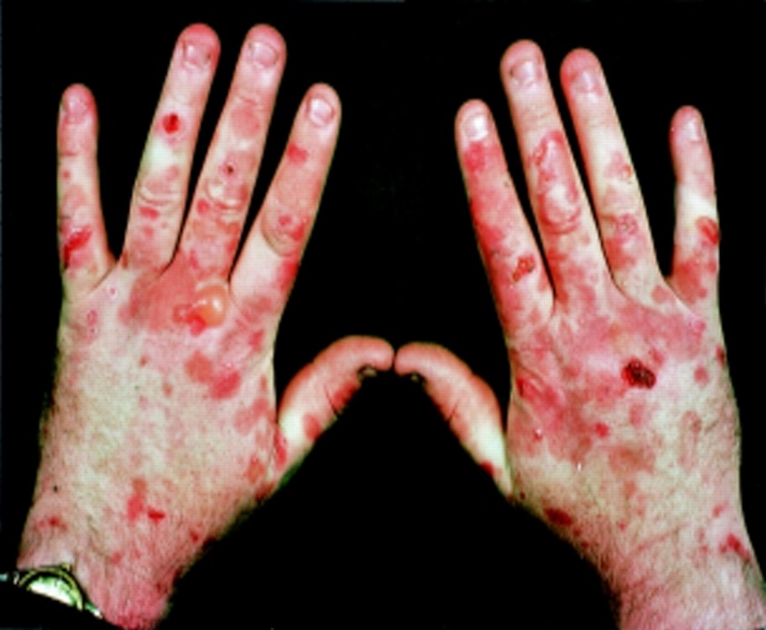
Symptoms
(i) Cutaneous (Skin lesions) – due to accumulation of URO,
PROTO and COPRO porphyrins (late intermediates of pathway).
Mild photo sensitivity severe blistering
Accumulation of porphyrinogens which are oxidized to their respective porphyrins.
They react with molecular oxygen to form O₂ radicals that cause cell damage and release of hydrolytic enzymes resulting in skin lesions.

Slide 18
(ii) Neuropsychiatric symptoms –
Peripheral neuritis
Abdominal pain
Both occur in porphyrias in which ALA and PBG are produced in excess and accumulated.
(iii) Neurocutaneous – accumulation of both early and late intermediates of pathway.
Porphyrias
Erythropoietic Hepatic
Enzyme deficiency in
erythroid tissues
Enzyme deficiency in the liver

Slide 19
HEPATIC PORPHYRIAS
(1)Acute intermittent porphyria:
  Due to deficiency of the enzyme UPG I synthase
  (PBG deaminase)
  Increased excretion of PBG and ALA in the urine.
  Urine is darkened (reddish) on exposure to air
Symptoms
  Abdominal pain
  Neuropshychiatric disturbances
  Pronounced after administration drugs that
  induce the ALA synthase (drugs are the commonest precipitating cause of disease eg. Barbiturates, sulfonamides, steroidal drugs), alcohol, hypoglycaemia
  No photosensitivity
Treatment -
Infusion of hematin (inhibit ALA synthase and prevent the accumulation of PBG)
PBG
Oxidation
Porphobilin

Slide 20
(2)Porphyria cutanae tarda (cutaneous hepatic porphyria)
  Commonest porphyria. Due to a deficiency in UPG decarboxylase and results in the increase excretion uroporphyrins.
Symptoms
  Cutaneous photosensitivity
(3)Hereditary coproporphyria
  Due to a deficiency of CPG oxidase. CPG III and
  other intermediates (ALA and PBG) of heme
  synthesis prior to the block are excreted in urine and
  faeces.
Symptoms
  Nuerocutaneous
Rx - Hematin

Slide 21
(4)Variegate porphyria
  Due to deficiency in PPG oxidase
  ALA,PBG and corpro III excreted in the urine and and protoporphyrins excreted in faeces.
  Urine has a reddish colour
Symptoms
  Nuerocutaneous
ERYTHROPOIETIC PORPHYRIA
(1)Congenital erythropoietic porphyria:
  Due to deficiency in UPG III cosynthase
  UPG I and CPG I are excreted in urine
  Oxidation of UPG I and CPG I respectively to
  UP I and CP I causes the urine to become red.
  Photosensitivity (cutaneous symptoms) and increased tendency for haemolysis

Slide 22
(2) Erythropoietic protoporphyria
Due to deficiency of the enzyme ferrochelatase.
Protoporphyrin accumulate in the tissues and is
excreted in faeces.
Photosensitivity
ACQUIRED PORPHYRIAS (secondary porphyria)
Lead poisoning
Heavy metals (lead) can inhibit ferrochelatase
and ALA dehydratse.
Causes an accumulation of corproporphyrin III
and ALA, which are excreted in the urine.
Increased erythrocyte zinc protpoprophyrin (ZPP).
Symptoms
Similar to acute porphyria
Lead to anaemia

Slide 23
Diagnosis of specific type of porphyria
    Family history
    Physical and clinical examination
    Laboratory tests.

Slide 24
Porphyria | Urine | Feces | Erythrocytes | Symptoms
AIP | ALA, PBG URO I | Normal | Normal | Neuropsychiatric
PCT | URO I ISOCOPRO | ISOCOPRO | Normal | Cutaneous
HCP | ALA, PBG COPRO III | COPRO | Normal | Neurocutaneous
VP | ALA, PBG, COPRO III | PROTO> COPRO | Normal | Neurocutaneous
CEP | URO I, COPRO I | URO I, COPRO I | URO, ZPP | Cutaneous
EP | Normal | PROTO> COPRO | PROTO | Cutaneous
Lead poisoning | ALA, COPRO (PBG Normal) |  | ZPP | Neuropsychiatric

Slide 25
THANK YOU

